Slide 1
AE361 Report
Group 1

Slide 2
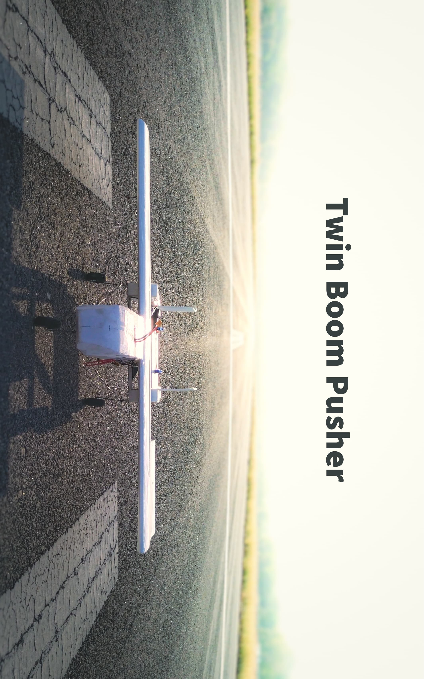

Slide 3
Members
Ambuj Pyne 210118
Yash Sinha 211195
Aryan Jalkote 210463
Mannu Dev Sah 210588
Shubh Jain 211018
Yash Hatwar 211188
Om Kothawade 210682

Slide 4
Contents
Introduction
Airfoil Specifications
Design Specifications
Electronic Specifications
Calculations
Constructed Plane
Purpose
Conclusion

Slide 5
Introduction
A radio-controlled aircraft (often called as RC aircraft or RC plane) is a small flying machine that is controlled by a remote through an operator on the ground using a hand-held radio transmitter. The transmitter communicates with a receiver within the craft that sends signals to servomechanisms (servos) which move the control surfaces based on the position of joysticks on the transmitter. The design of RC plane involves aerodynamics, woodworking, composite materials, electronics, mechanics, small motors drafting, artistry, and club activities practically all at the same time.
Twin pusher aircraft are an intriguing type of aircraft design where propulsion units, typically engines or propellers, are placed at the rear of the aircraft, pushing it forward. As the name suggests, these aircraft have two such propulsion units, one on each side of the fuselage.

Slide 6
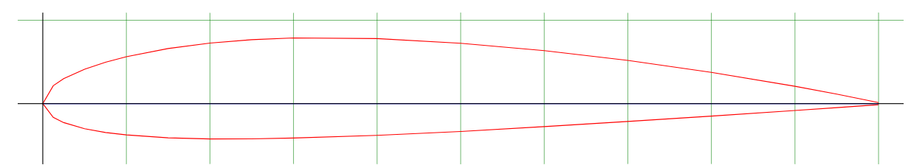
Airfoil Specifications
NACA 2412
Chord length– 23 cm
Maximum Camber- 2% located at 0.4 of the chord length from LE
Maximum Thickness- 12% of the chord

Slide 7
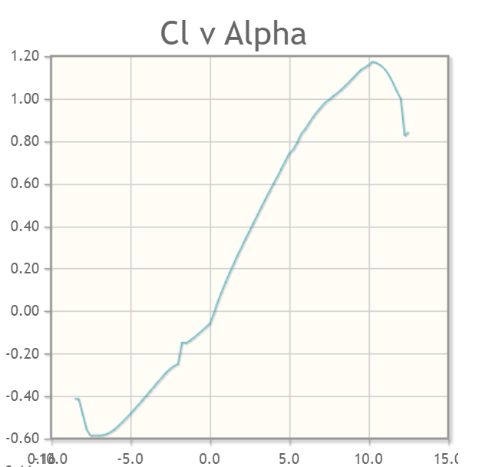
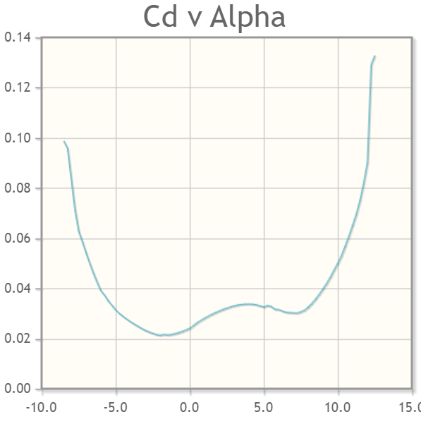
Airfoil Specifications

Slide 8
Design Specifications
Weight- 969 gm
Total Length – 42 cm + 18 cm+ 20 cm = 80 cm
Fuselage Length – 42 cm
Fuselage Width – 10 cm
Boom Rod Length – 18 cm
Wing Span- 1.25 m
Horizontal Tail Span- 40 cm
Aileron Length - 30 cm
Elevator Length = 30 cm
Rudor Height = 15 cm
Propeller Length- 12 cm radius (pusher type)

Slide 9
Electronic Specifications
Battery- 2200mAh 3S 30C/60C (LiPo)
Motor - DYS 1100kv BLDC Motor
ServoX4 - (2x Aileron, 2x elevator)
ESC - 30A ESC
Receiver - FlySky 10 channel
Type of Engine- Brushless DC Motor
Material Used- Thermocole, Sunboard

Slide 10

Calculations
Aerodynamic Center- C/4 = 23/ 4 = 5.75 cm from LE of wing
Center of Gravity = 5.7 cm from LE of wing
The 3D lift coefficient slope, with angle of attack depends on the 2D lift coefficient slope.
cl_{α}= 11.66
CL_{o}= -0.059
CD_{o} = 0.024
Cl_{α} = 6.93
CL= -0.059 + 6.928 α
When the fuselage reference line was horizontal, the wing angle of attack was 5 degrees.
CL₅= 0.545

Slide 11


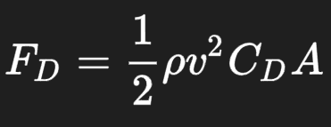
Calculations
CD = 0.042
L = W = 0.969 * 9.8 = 9.49 N
L = 0.096 * v * v = 9.49 N
This implies, v = 9.94 m/s
D = 0.731N ( which is less than 1 N)

Slide 12
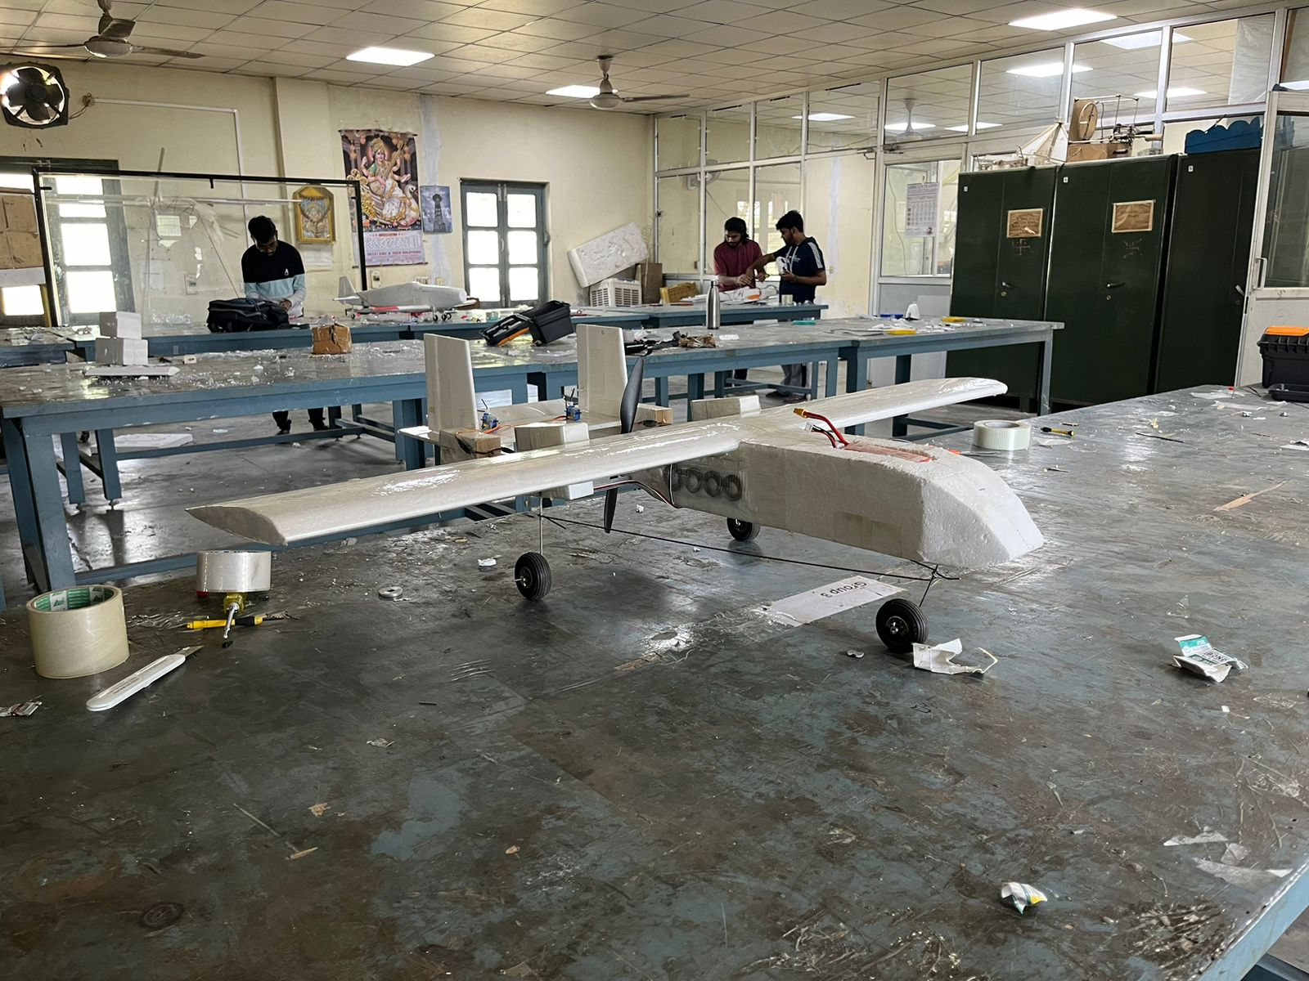
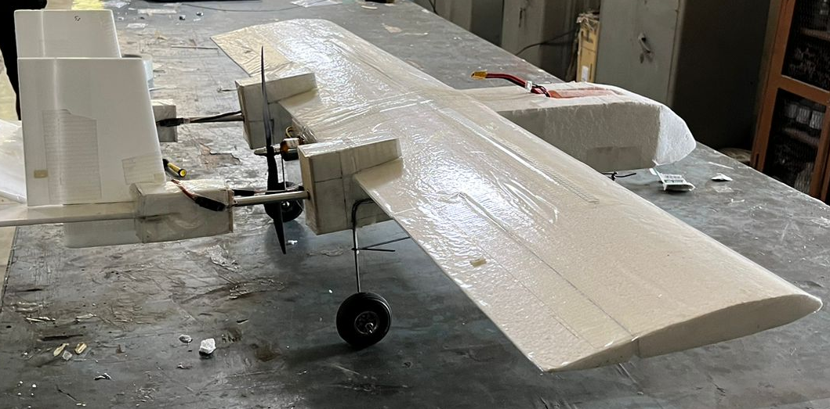
Constructed Plane

Slide 13
Purpose
Twin boom pusher aircraft are designed with the propulsion system located at the rear of the fuselage, between two booms extending rearward from the wings or tail. This configuration offers several advantages:
Reduced Noise and Vibration: Placing the engines at the rear can reduce noise and vibration in the cockpit and cabin, offering a quieter and smoother ride for passengers and crew.
Improved Visibility: With the engines behind the cabin, there's typically better visibility from the cockpit, enhancing safety and situational awareness for pilots.
Unobstructed Cargo/Payload Area: The absence of engines under the wings or on pylons allows for a more spacious cargo or payload area, which can be useful for transporting goods or specialized equipment.
Enhanced Maneuverability: The propulsion system's position can improve the aircraft's maneuverability, especially in certain flight regimes like high angles of attack or during take-off and landing.
Simplified Wing Design: By removing the need for engine mounts or pylons under the wings, the wing design can be simplified, potentially reducing weight and increasing efficiency.
These aircraft are commonly used for various purposes, including reconnaissance, surveillance, cargo transport, and sometimes even passenger transportation. Their configuration offers versatility and efficiency for different mission profiles.

Slide 14
Conclusion
An attempt has been made to systematically design, analyze, build and fly a model RC plane. This project provides an insight into basics of aircraft design, engineering, building and testing on a small scale. Aircraft technology fundamentals are also known and use of design and analysis tools. The project also provided an opportunity for multi-disciplinary terms to work together.

Slide 15


